Slide 1

Social Science Research Design and Statistics, 2/e
Alfred P. Rovai, Jason D. Baker, and Michael K. Ponton
Mann-Whitney U Test
PowerPoint Prepared by
Alfred P. Rovai
IBM® SPSS® Screen Prints Courtesy of International Business Machines Corporation,
© International Business Machines Corporation.

Slide 2
Uses of the Mann-Whitney U Test
The Mann-Whitney U test is a nonparametric procedure that determines if ranked scores (i.e., ordinal data) in two independent groups differ. It is also used to analyze interval or ratio scale variables that are not normally distributed.
This test is equivalent to the Kruskal-Wallis H test when only two independent groups are compared.
This test is useful when when the normality assumption of the independent t-test is not tenable.

Slide 3
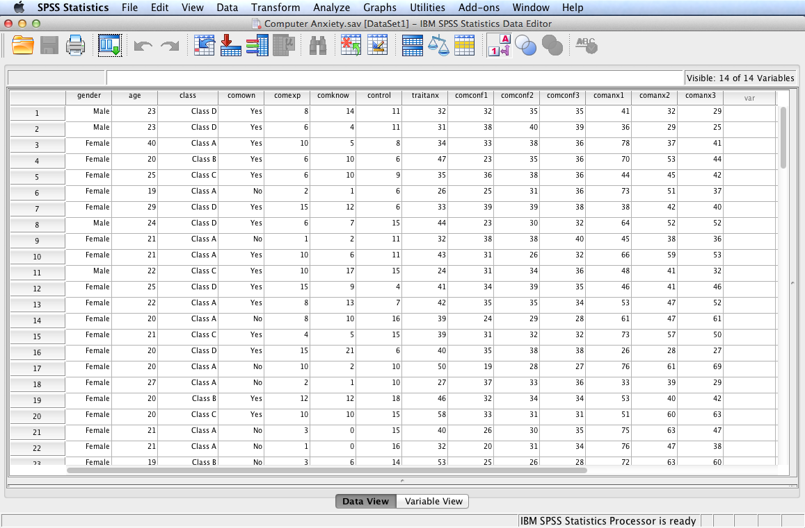
Open the dataset Computer Anxiety.sav.
File available at http://www.watertreepress.com/stats

Slide 4
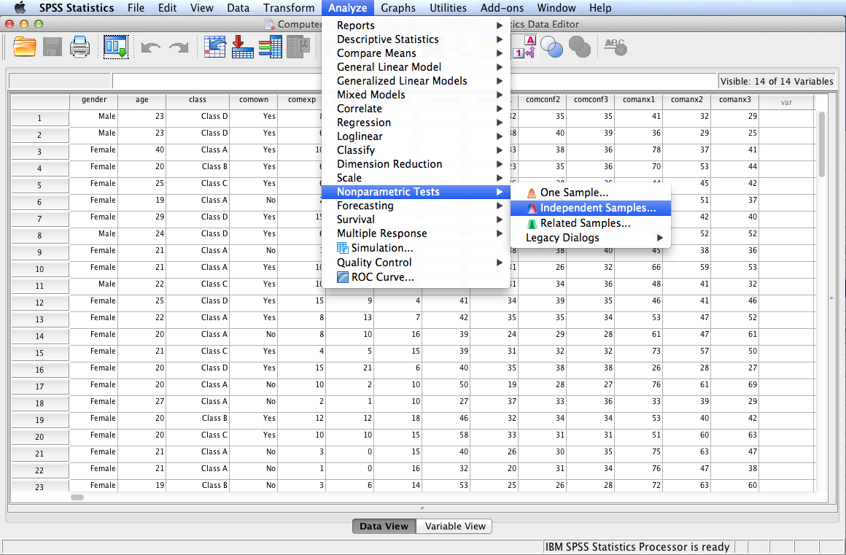
Follow the menu as indicated. Alternatively, one can use the Legacy Dialogs as shown on the following slides.

Slide 5
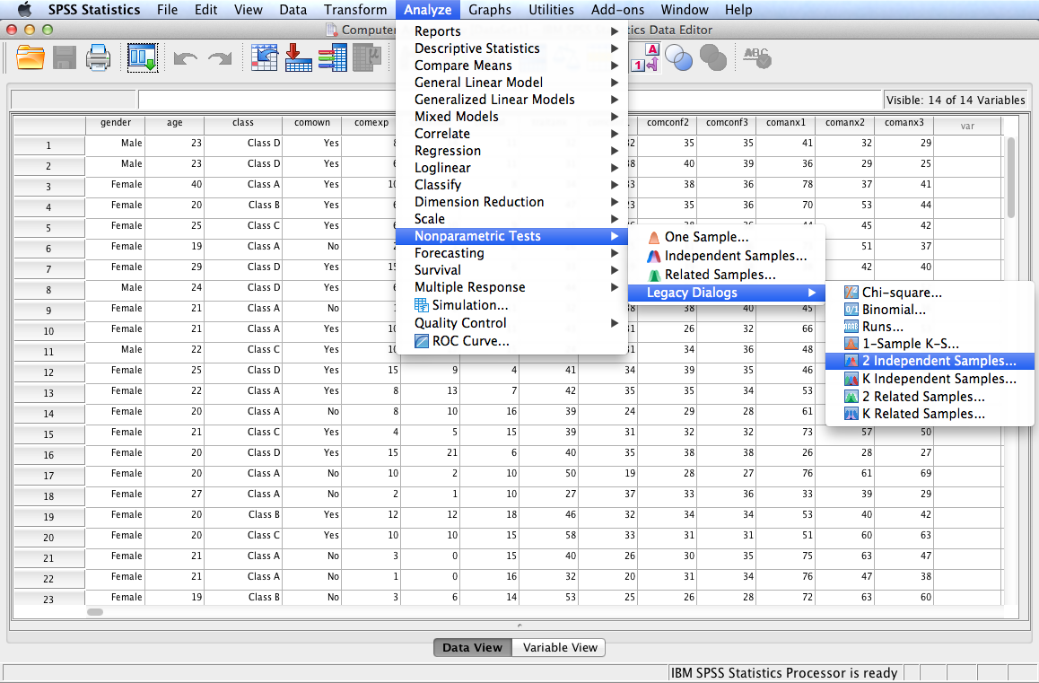
Follow the menu as indicated to use Legacy Dialogs. Alternatively, one can run the test using the Independent Samples option under the Nonparametric Tests menu.

Slide 6
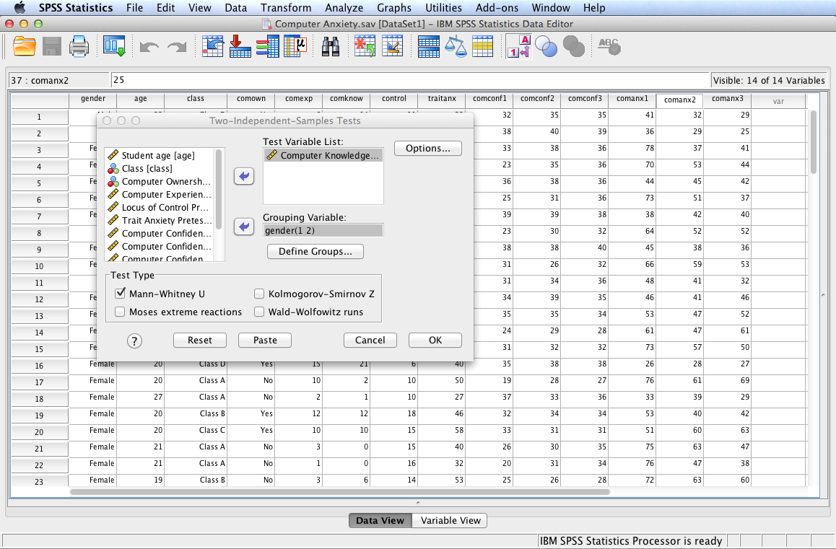
In this example, we will test the following null hypothesis:
H_{o}: There is no difference in how the ranks of computer knowledge pretest are dispersed between male and female university students.
Select and move Computer Knowledge Pretest to the Test Variable List:. Check Mann-Whitney U as the Test Type. Click Options...

Slide 7
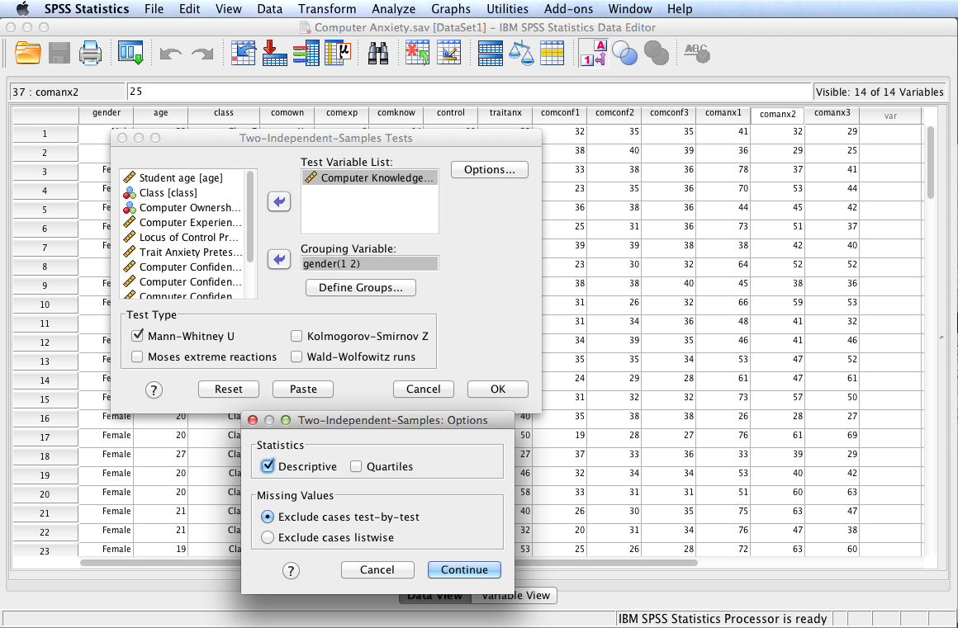
Check Descriptive to generate descriptive statistics; click Continue then OK.

Slide 8
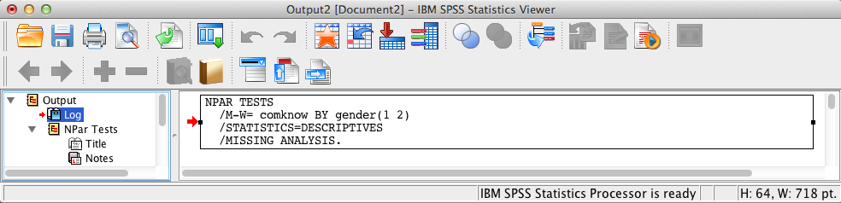
SPSS Output
The contents of the SPSS Log is the first output entry. The Log reflects the syntax used by SPSS to generate the Npar Tests output.

Slide 9
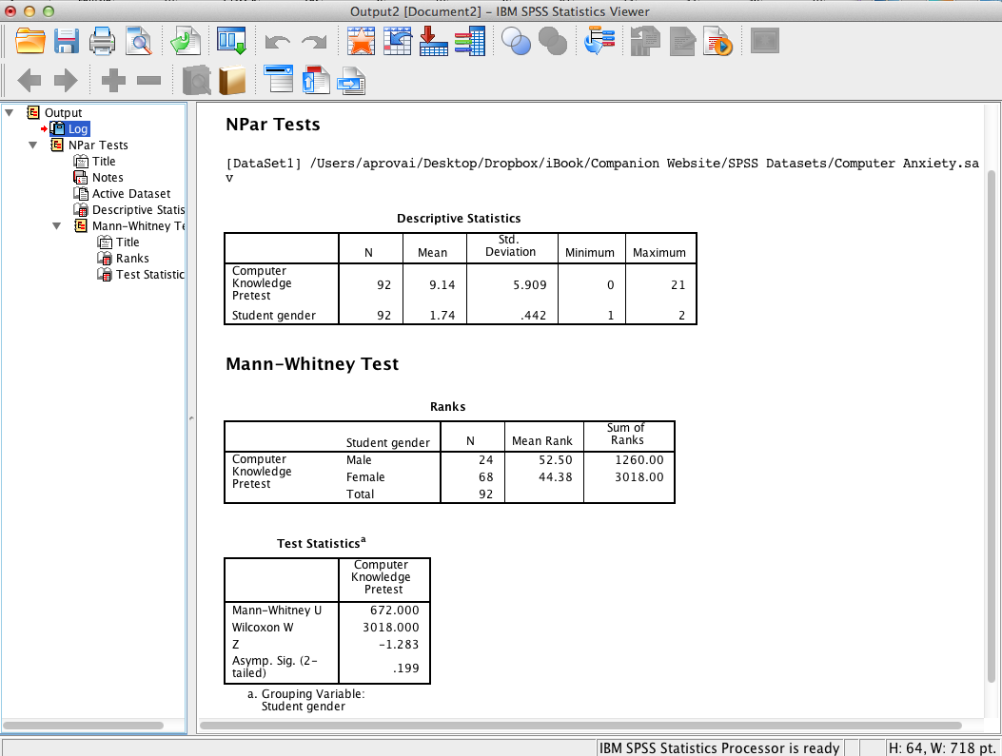
SPSS Output
SPSS output includes descriptive statistics to include a summary of ranks. SPSS output also displays test statistics that show an insignificant difference, p = .20, between males and females since the asymptotic significance level >= .05 (the assumed à priori significance level).

Slide 10
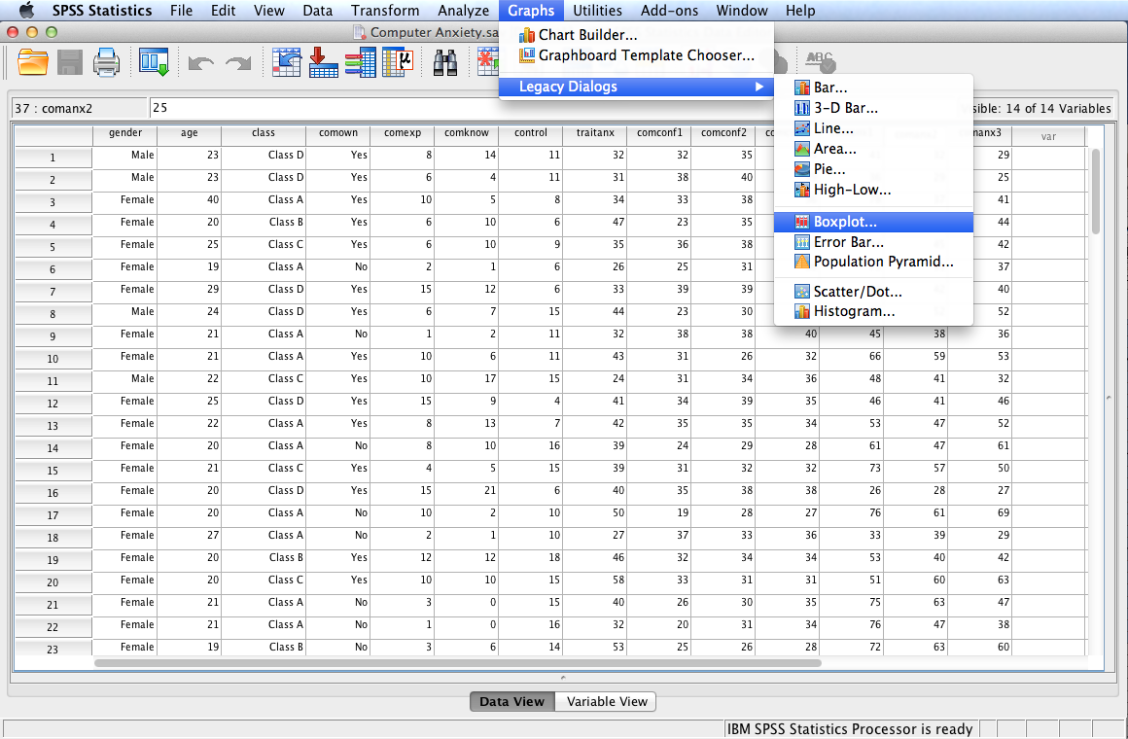
Follow the menu as indicated to generate side-by-side boxplots.

Slide 11
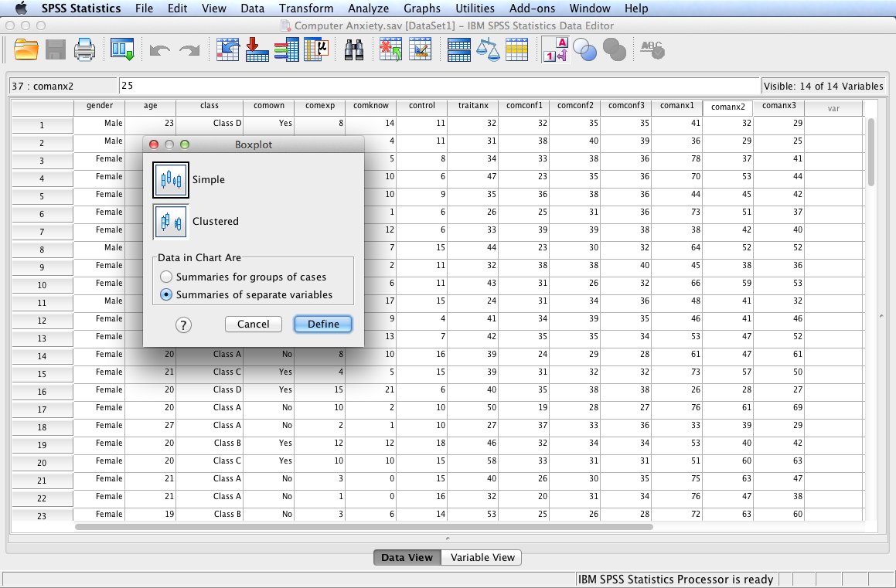
Select Simple and Summaries of separate variables; click Define.

Slide 12
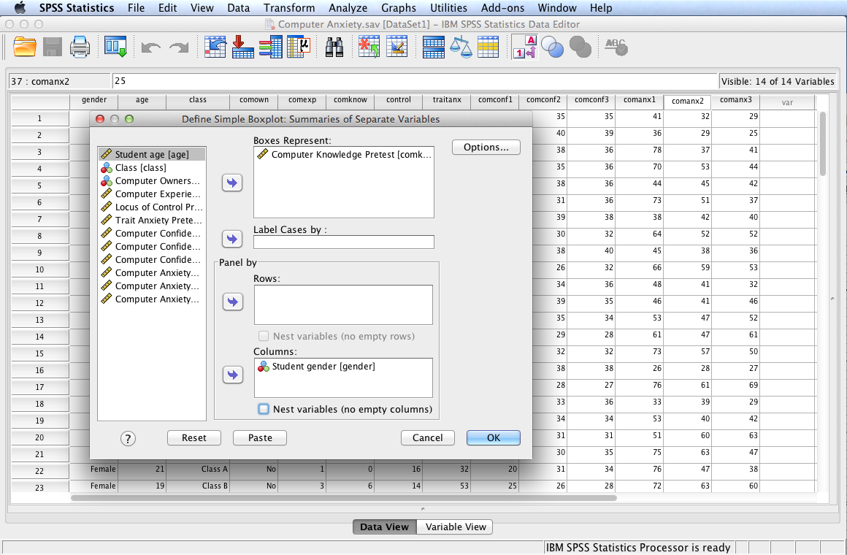
Move Computer Knowledge Pretest to the Boxes Represent: box and Student Gender to the Columns: box; click OK.

Slide 13
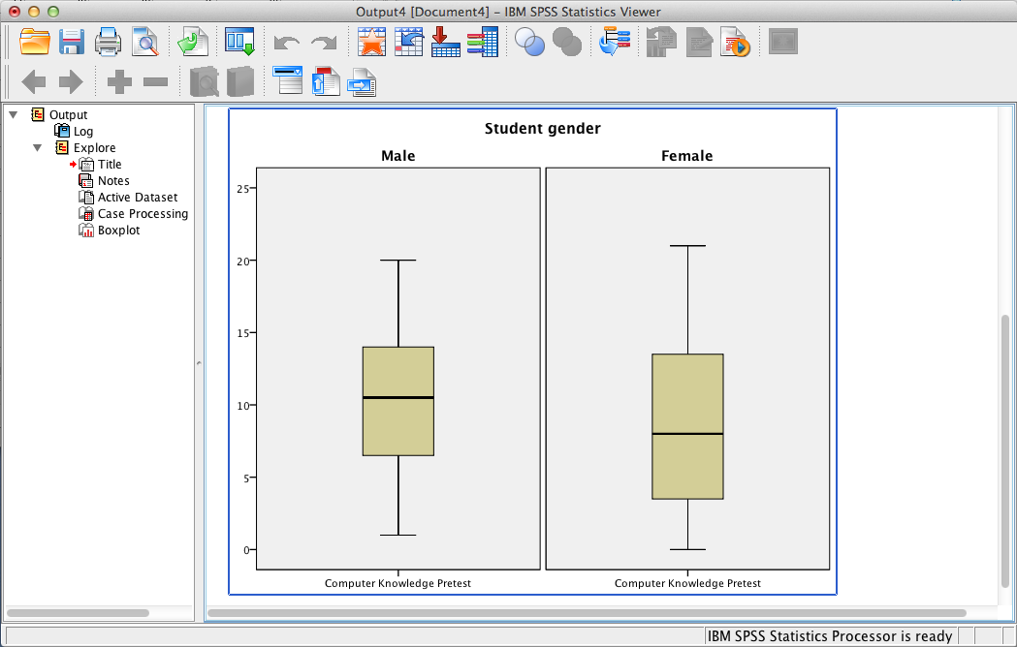
SPSS Output
SPSS output includes a figure of two boxplots displaying the distributions of male and female computer knowledge pretest.
The similarity of the distributions support a non-significant difference between the two.

Slide 14
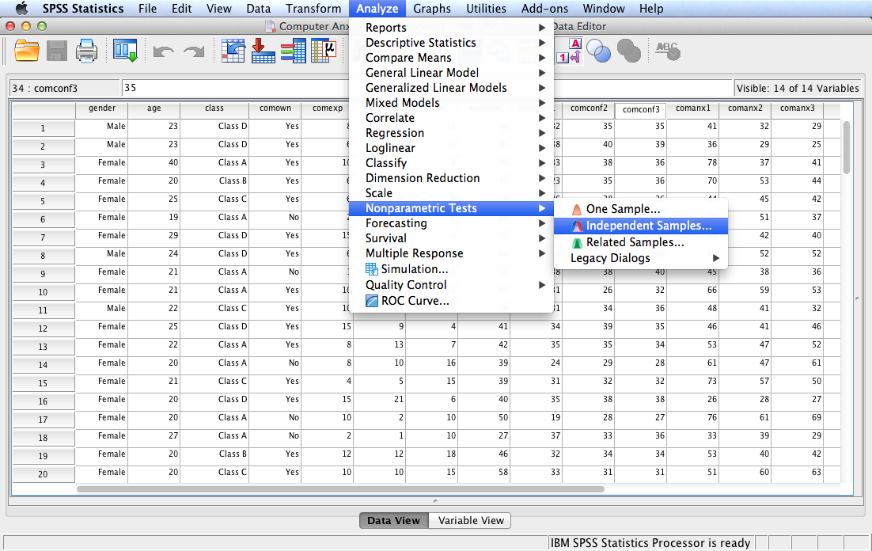
One can also run the test using the Independent Samples option under the Nonparametric Tests menu.

Slide 15
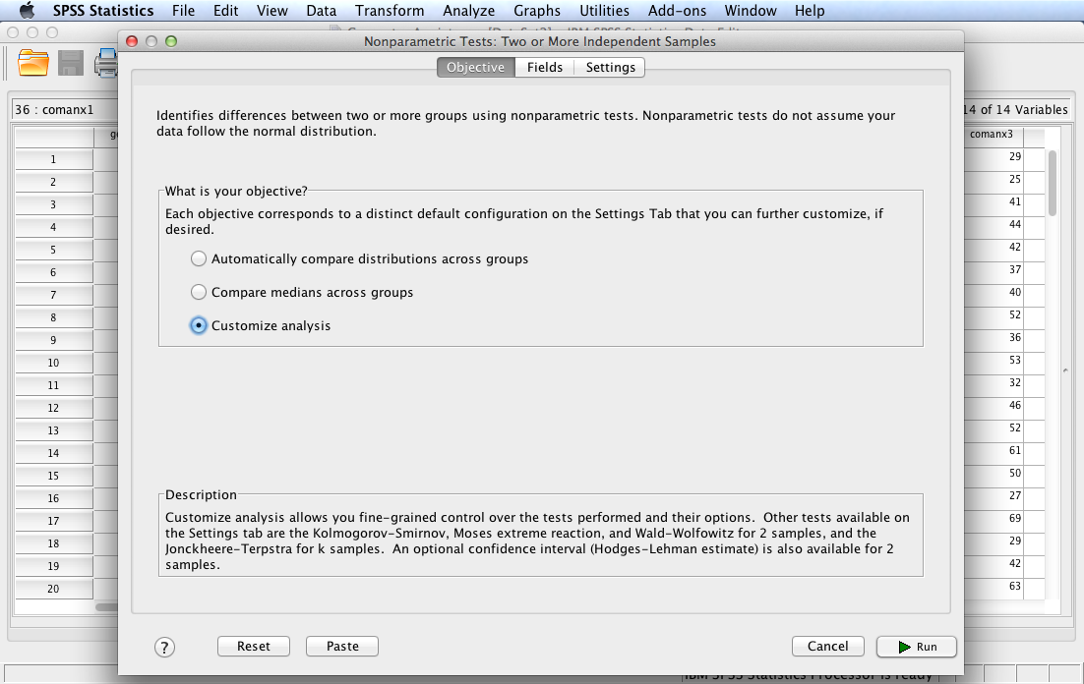
Select Customize analysis and then click the Fields tab.

Slide 16
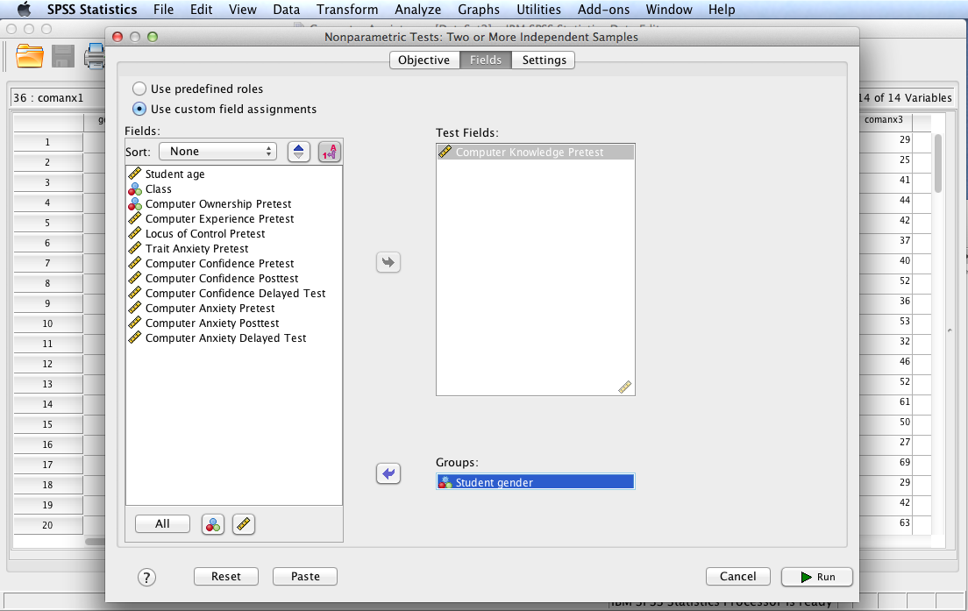
Move Computer Knowledge Pretest to the Test Fields: box and Student Gender to the Groups: box. Click the Settings tab.

Slide 17
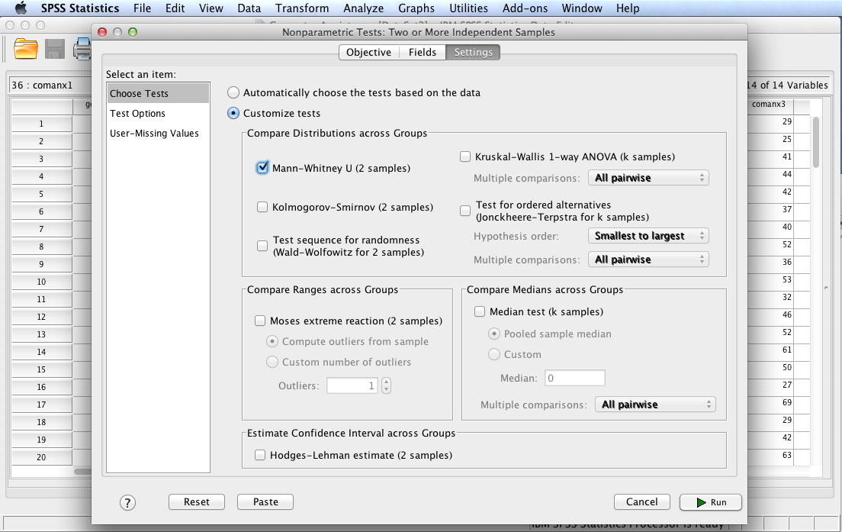
Select Customize tests and Mann-Whitney U (2 samples). Click Test Options.

Slide 18
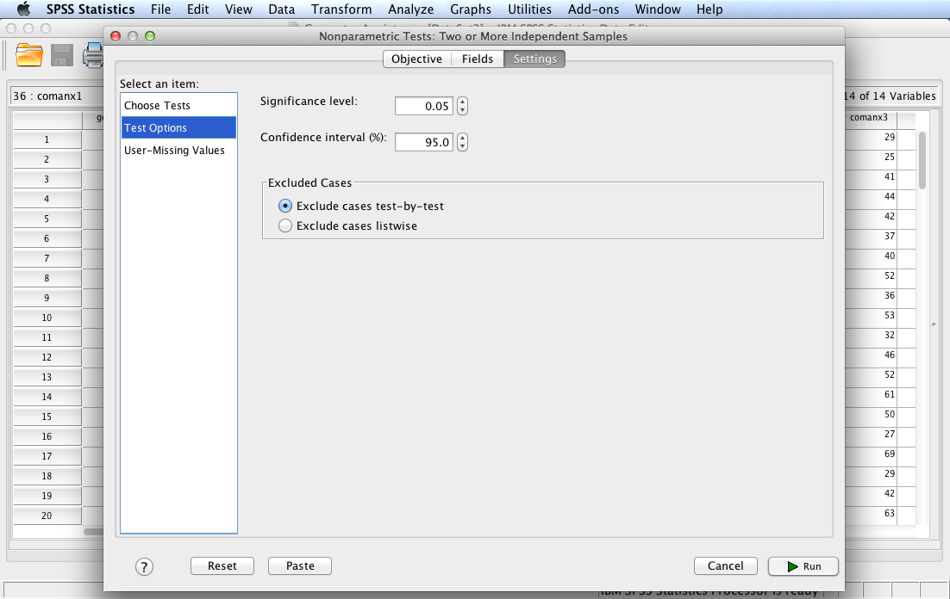
Note and select the default values by clicking Run to execute the procedure.

Slide 19
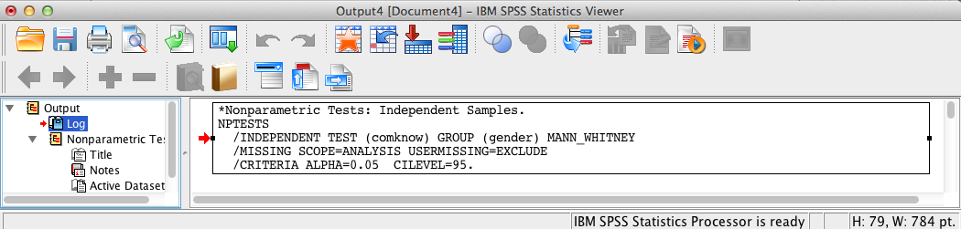
SPSS Output
The contents of the SPSS Log is the first output entry. The Log reflects the syntax used by SPSS to generate the Nonparametric Tests output.

Slide 20
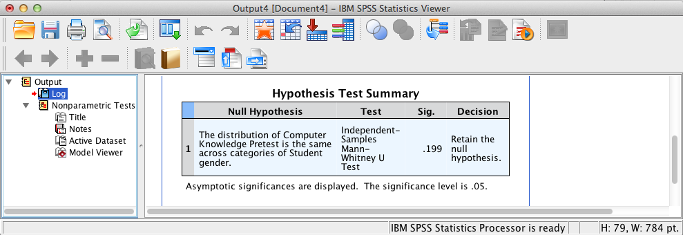
SPSS Output
SPSS output displays the Mann-Whitney summary statistics. Double-click the table in the SPSS output window to display the Model Viewer.

Slide 21
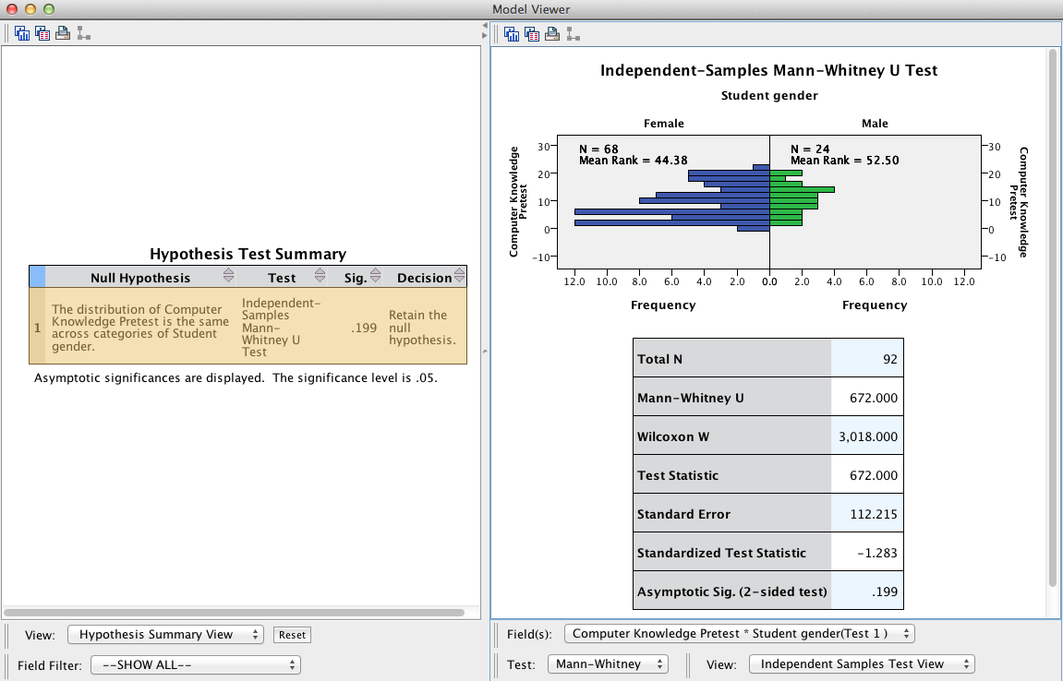
SPSS Output
Select Categorical Field Information from the View: pop-up menu to display a bar chart for Student Gender.

Slide 22
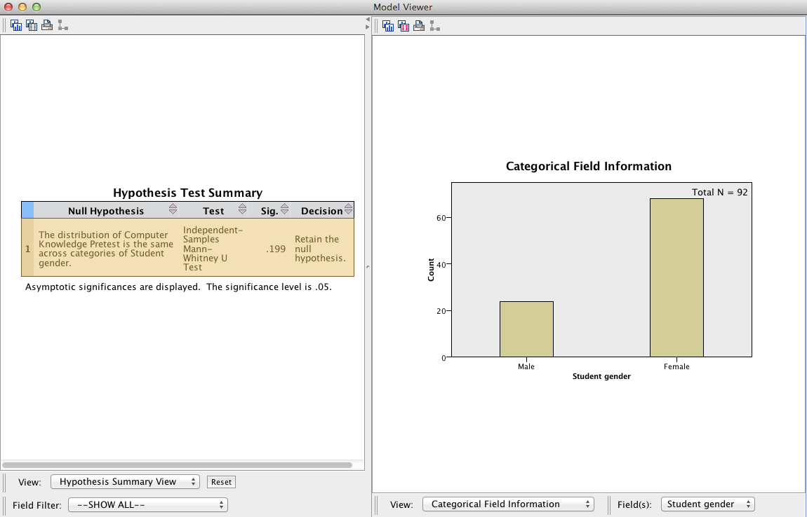
SPSS Output
Select Continuous Field Information from the View: pop-up menu to display a histogram for Computer Knowledge Pretest.

Slide 23
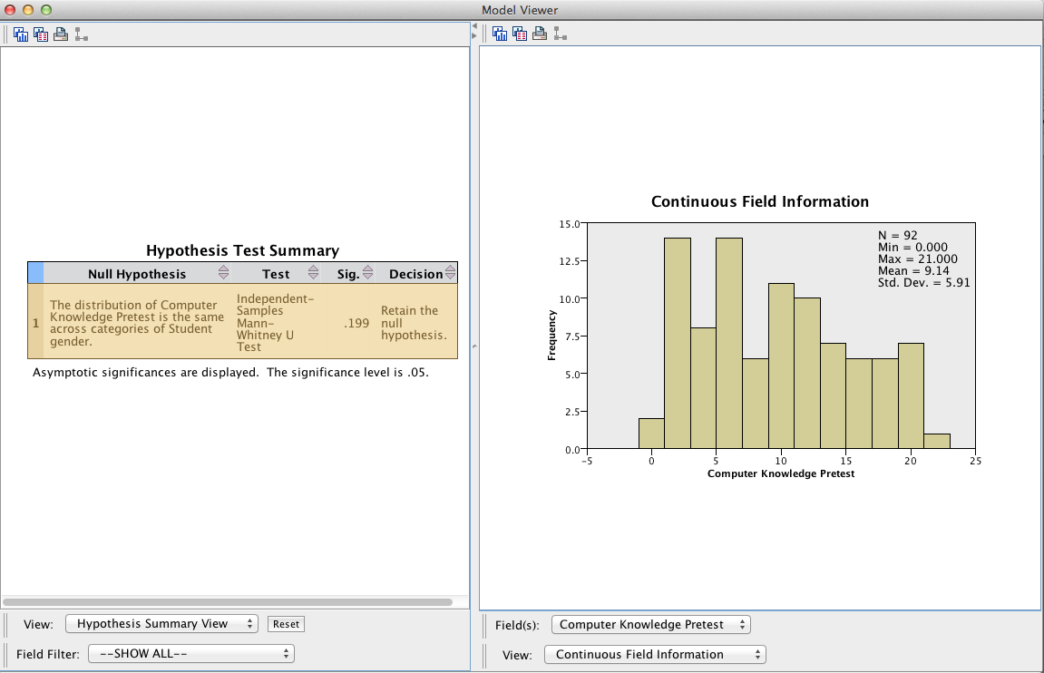
SPSS Output

Slide 24
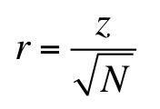
Mann-Whitney U Test Results Summary
H₀: There is no difference in how the ranks of computer knowledge pretest are dispersed between male and female university students. The Mann-Whitney U test is not significant, U = 672.00, z = –1.28, p =.20. Consequently there is insufficient evidence to reject the null hypothesis of no difference between male and females.
Note: for a significant test one should also report effect size using the r-approximation. An approximation of the r coefficient can be obtained using the following formula:
where N = total number of cases and z = the z-value produced by SPSS (see Test Statistics table in SPSS output above). In this case r = -.13, representing little if any effect.

Slide 25
End of Presentation

